Slide 1

Medical Imaging & Big Data
Data Science Master’s Degree
2024 – 2025
Deep Learning for Brain Tumor Segmentation:
From Dropout to Residual U-Nets with Augmentation
Induni Sandapiumi Nawarathna Pitiyage – 906451
Sara Campolattano – 906453

Slide 2
Content Outline
Introduction & Data Preprocessing
Phase 1: Baseline U-Net with Dropout
Phase 2: Data Augmentation Integration
Phase 3: Residual Connections in U-Net
Phase 4: Combined Enhancements
Results Comparison & Conclusions

Slide 3
Introduction and Data Preprocessing
This project focuses on the development of a deep learning pipeline for semantic segmentation of brain tumors from MRI scans.
The goal is to explore and progressively improve a U-Net-based architecture by incorporating key enhancements such as dropout regularization, data augmentation, and residual connections.
The data entailed is taken from the BRATS dataset, which includes pre-operative MRI scans from two groups:
LGG (Low-Grade Glioma)
GBM (Glioblastoma Multiforme)

Slide 4
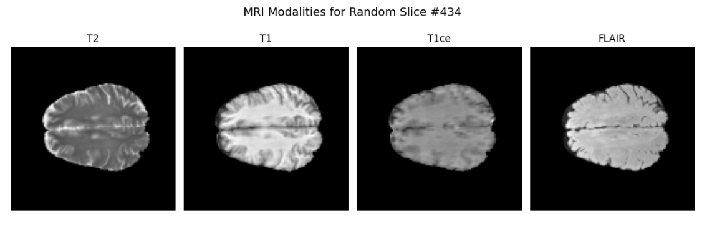
Introduction and Data Preprocessing
Each sample contains multimodal 3D MRI volumes, typically with 4 channels:
T1-weighted
T1c (contrast-enhanced)
T2-weighted
FLAIR

Slide 5
Introduction and Data Preprocessing
To prepare the data for modeling:
Volumes were resized to 120 × 120 × 77 voxels to ensure uniform input shape
All voxel intensities were scaled and normalized.
Masks were converted to one-hot encoded arrays with binary channels for each class.
The dataset was split into:
67% for training 🡪 46 patients
33% for testing 🡪 24 patients
Split is stratified by patient volumes: each patient's 3D volume contributes 77 slices to the 2D training set. Preprocessed data is reshaped into 2D slices to support 2D convolution layers.
The aim is therefore to evaluate how architectural and training enhancements affect segmentation performance, measured through Dice similarity coefficient on tumor subregions

Slide 6
Phase 1: Baseline U-Net with Dropout
The first phase is meant to implement a baseline segmentation model using a classic U-Net architecture with dropout regularization. The goal is to establish reference performance using core MRI inputs.
The model processes 2D MRI slices of shape 120×120×4 (four modalities per slice) and outputs a pixel-wise segmentation map with 4 softmax-activated channels.
The architecture was defined as follows:
Encoder: - three encoder blocks, each with: - two Conv2D layers (ReLU, padding='same’) - Dropout layers which rates increases with depth: 0.2 → 0.2 → 0.3 - MaxPooling2D to reduce spatial dimensions
Bridge: - three Conv2D layers with 128 filters - final dropout with a higher rate of 0.4
Decoder: - three decoder blocks, each composed of: - UpSampling2D for resolution - two Conv2D layers (ReLU, padding='same’) - Dropout at each level: 0.3 → 0.2 → 0.2
Output Layer: - final Conv2D layer with 4 - Softmax activation for multi-class segmentation per pixel

Slide 7
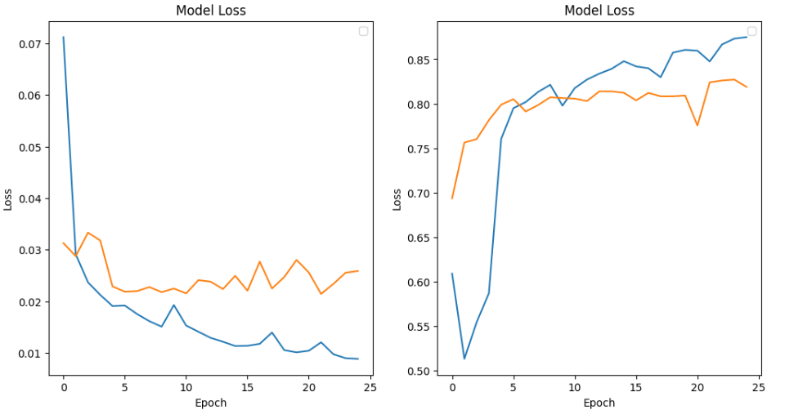

Phase 1: Baseline U-Net with Dropout
The model was compiled and then fit using categorical loss and trained using:
Batch size of 8
25 epochs

Slide 8
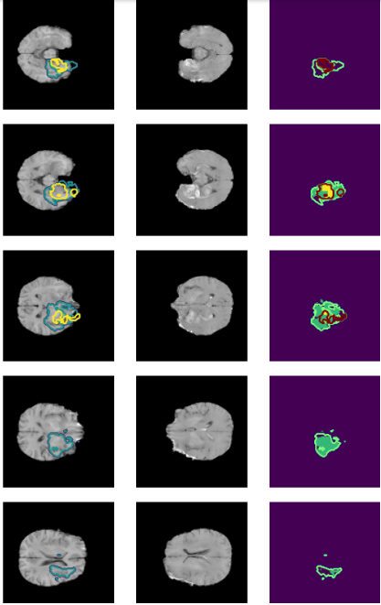
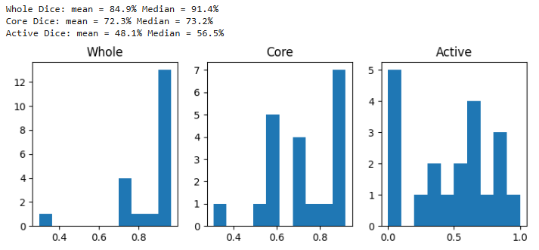
Phase 1: Baseline U-Net with Dropout
To assess segmentation quality, a custom Dice coefficient function was implemented to report that:
The Whole tumor segmentation is strong, with scores tightly clustered above 0.85. The mean is 84.4% and median is 89.9%, consistent with the best phases following.
The Core tumor performance is notably solid, with a mean of 74.2% and median of 79.7%, indicating improved consistency and reduced variance compared to the following phases.
The Active tumor Dice scores are significantly better than Phases 1 and 2, with a mean of 60.1% and median of 72.0%, and a clear concentration of values above 0.6.

Slide 9
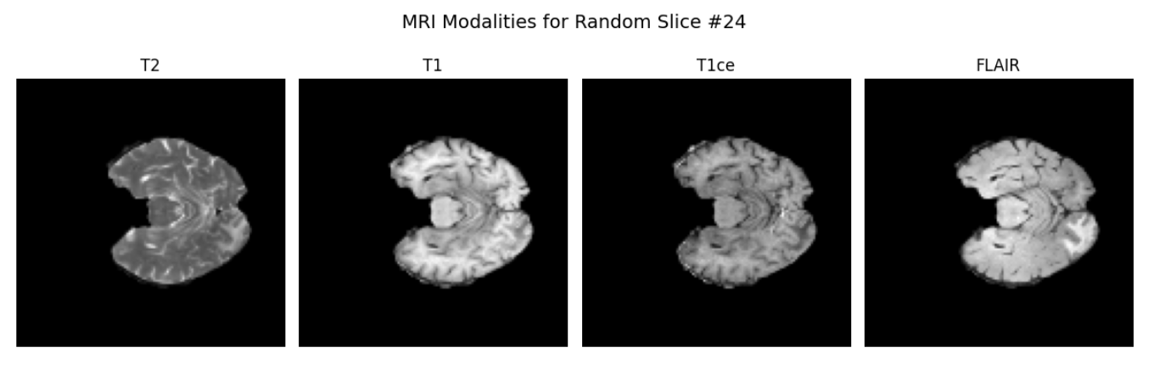
Phase 2: Data Augmentation Integration
In this phase, we aimed to improve generalization by increasing data diversity. We retained the U-Net architecture with dropout from Phase 1 and introduced a custom data augmentation pipeline for only 50% of the training data (i.e., 23 patients) applied directly to training slices.
A custom augmentation function was applied the training set, producing diverse transformed images:
Spatial: horizontal/vertical flips, random image roll
Intensity: brightness, contrast jitter, multiplicative scaling
These augmentations aim to simulate realistic scanning variations and anatomical shifts.

Slide 10
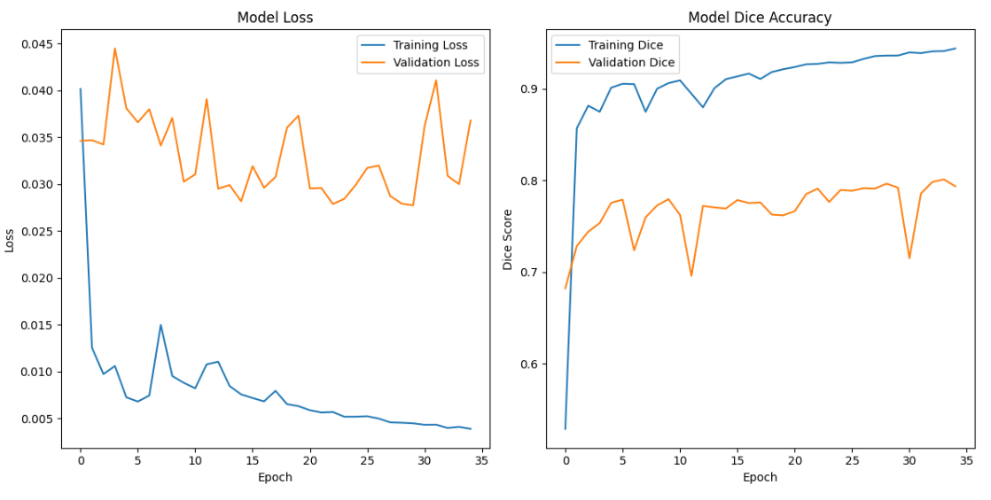
Phase 2: Data Augmentation Integration
In this case, the U-Net model previously defined was fit with: - batch size of 8 - 35 epochs
Also in this case, a custom Dice coefficient accuracy function was implemented.

Slide 11
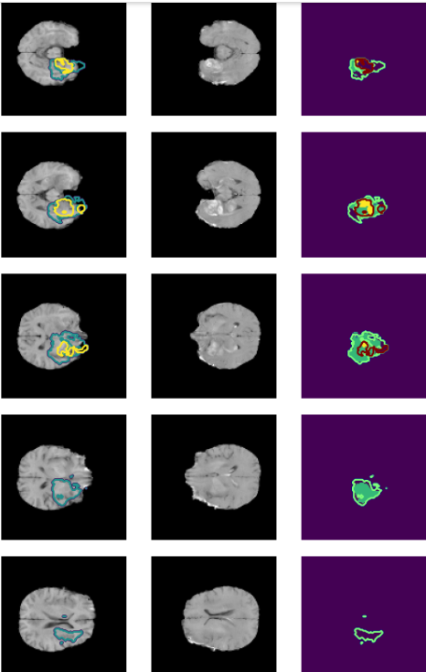
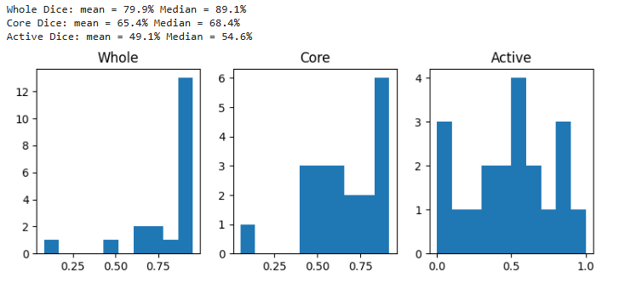
Phase 2: Data Augmentation Integration
The Whole tumor segmentation performs fairly well, with a mean of 79.9% and a high median of 89.1%, suggesting some low outliers but generally accurate results.
The Core tumor scores are more dispersed, with a mean of 65.4% and median of 68.4%, indicating less consistent segmentation across patients.
The Active tumor Dice scores are the weakest, with a mean of 49.1% and a median of 54.6%, showing a broad spread and multiple predictions under 0.5 — a sign of difficulty segmenting fine-grained tumor structures.

Slide 12
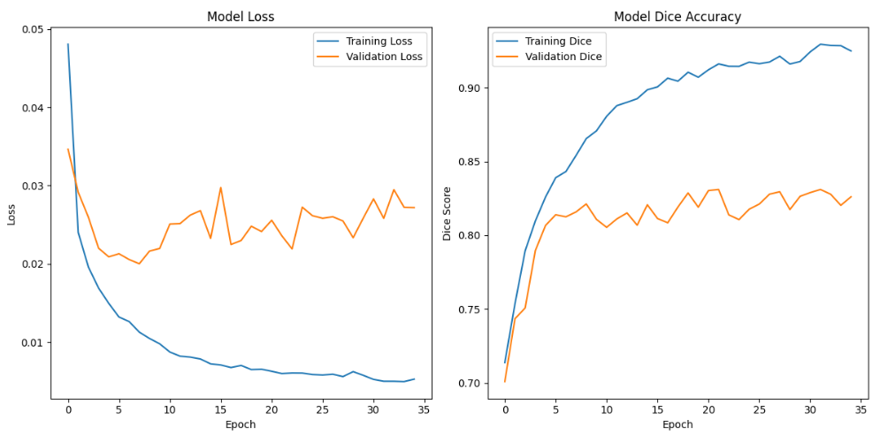
Phase 3: Residual Connections in U-Net
The aim of this phase is to explore architectural improvements to the U-Net from Phase 1 by integrating residual connections within the encoder, bridge and decoder blocks. The goal is to enhance the model’s capacity to learn deeper, more expressive features without degradation in training performance.
Each block includes:
Two Conv2D layers (3×3)
Dropout with increasing rate
A 1×1 Conv2D shortcut to match dimension
In this case, the U-Net model previously defined was fit with: - batch size of 8 - 35 epochs
Note: no data augmentation was employes in this phase

Slide 13
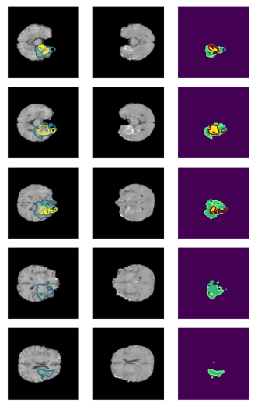
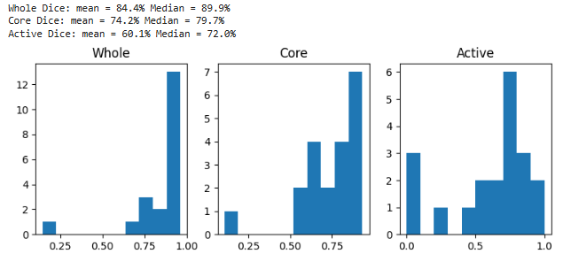
Phase 3: Residual Connections in U-Net
The Whole Dice scores are highly concentrated above 0.85, with a mean of 84.4% and median of 89.9%, indicating strong and consistent segmentation performance.
The Core tumor Dice scores show slightly more variability, with a mean of 74.2% and median of 79.7%, reflecting good but less uniform segmentation.
The Active tumor segmentation is the most challenging, with wider spread and a mean Dice of 60.1%. However, a median of 72.0% shows that many predictions were still accurate.

Slide 14
Phase 4: Combined Enhancements
The final experimental phase aims to combine the strengths of residual connections and data augmentation to try to maximize model generalization and segmentation precision.
The Augmentation function includes:
Spatial transforms: roll, flip (horizontal & vertical)
Intensity changes: scaling, brightness and contrast variation
The final training set contains data: original + augmented + shuffled split
The is therefore a Residual U-Net, with:
encoder–decoder using residual blocks, where each block includes: - Two Conv2D layers (3×3) + ReLU - A 1×1 Conv2D shortcut path - increasing Dropout rates followed by ReLU - Output: Conv2D(4) with softmax activation for 4-class segmentation

Slide 15
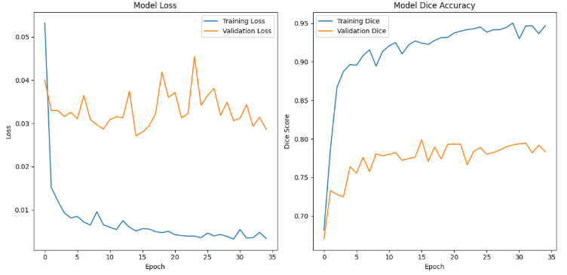
Phase 4: Combined Enhancements
In this case, the U-Net model previously defined was fit with:
batch size of 8
35 epochs

Slide 16
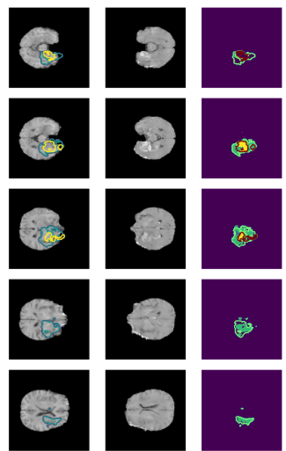
Phase 4: Combined Enhancements
In this phase, the segmentation masks appear to be the visually clear.

Slide 17
Results Comparison & Conclusios
Across all phases, we observed steady improvements in training behavior and segmentation quality:
Phase 1 showed solid Dice performance but also signs of overfitting and masks with irregular, fragmented boundaries.
Phase 2 slightly lower validation accuracy and noisy masks suggest overfitting to augmented data.
Phase 3 offered the best balance: with a validation Dice of 0.82 and noticeably cleaner, more coherent segmentations, especially in active tumor regions.
In Phase 4, despite reaching the lowest training loss and highest Dice during training, validation Dice slightly dropped. However, the segmentation masks in Phase 4 were the most visually accurate, capturing finer details and tumor borders with greater precision than any prior model.
Phase | Train Loss | Validation Loss | Train Dice Accuracy | Validation Dice Accuracy
Phase 1 | 0.0087 | 0.0259 | 0.8755 | 0.8188
Phase 2 | 0.0041 | 0.0368 | 0.9435 | 0.7937
Phase 3 | 0.0052 | 0.0272 | 0.9265 | 0.8261
Phase 4 | 0.0035 | 0.0287 | 0.9454 | 0.7833

Slide 18
THANK YOU FOR YOUR ATTENTION!

